Slide 1

CSC 808: ADVANCED COMPUTER ARCHITECTURE Lecture Note 1 Ass. Prof O. N. akande
Lecturer:
Akande Noah O. (Ph. D.)
Notes:
CYB 482

Slide 2
Advanced Computer Architecture
Computer architecture refers to the design and organization of a computer system, focusing on how various components interact to execute instructions efficiently.

Slide 3
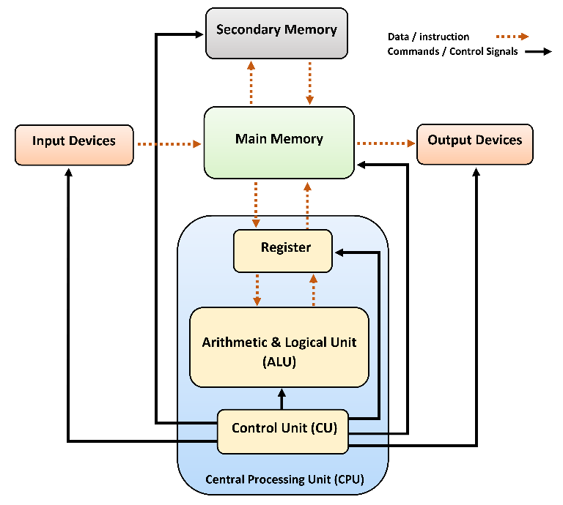

Slide 4
Components of Computer Architecture
Instruction Set Architecture (ISA): Defines the set of machine instructions a processor can execute, including data types, registers, addressing modes, and execution control.
Microarchitecture: The internal design of a processor, including pipeline structure, execution units, and cache organization, which determines how instructions are processed.
Memory Hierarchy: captures how storage components (registers, cache, RAM, and secondary storage) are organized to balance speed and capacity efficiently.

Slide 5
Components of Computer Architecture
Input/Output (I/O) System: Manages communication between the processor, memory, and peripherals, ensuring seamless data transfer.
Control Unit & Data Path: Directs the operation of the processor, handling instruction decoding, execution, and data movement.
Notes:
Crude Oil, Gold mining

Slide 6
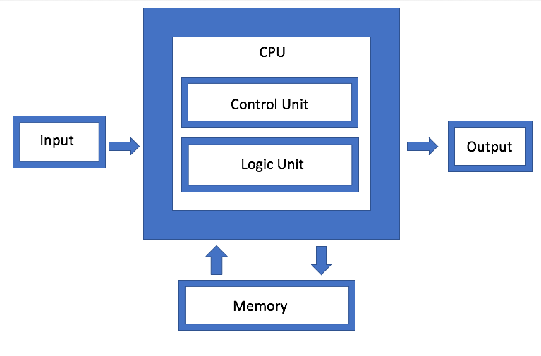
Evolution of Computer Architecture
Von Neumann architecture is a computer design that stores both data and instructions in the same memory
Two key principles:
Stored Program Concept
Sequential Instruction Execution
Notes:
Instructions are fetched and executed one at a time in a specific order

Slide 7
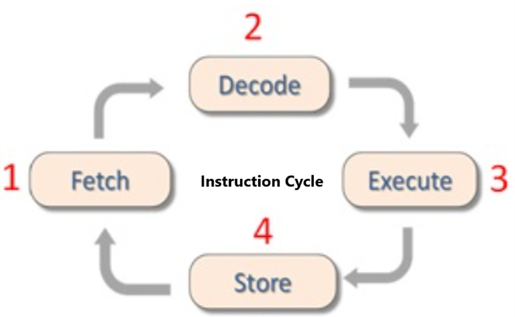

Slide 8
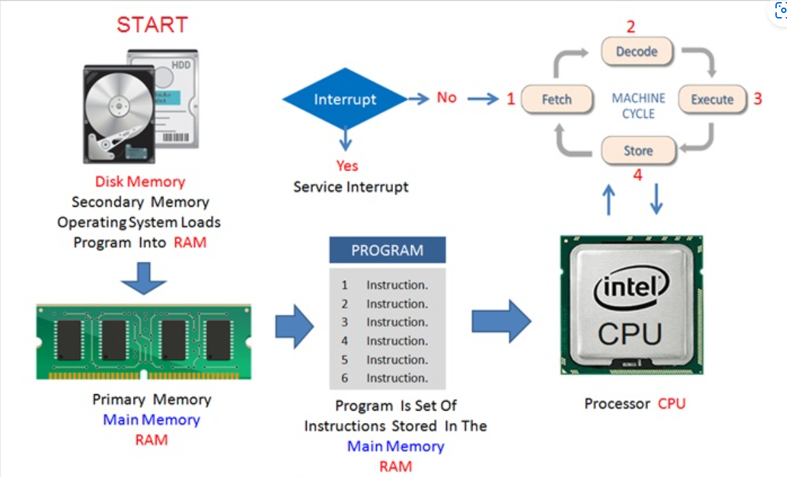

Slide 9
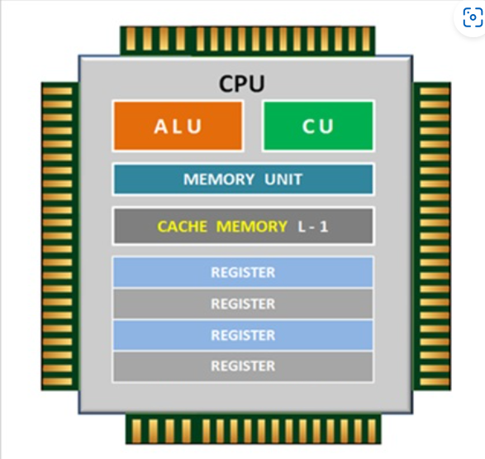

Slide 10
Limitations of Von Neumann Architecture
Memory Bottleneck: Shared memory slows down data and instruction transfer.
Sequential Processing: Cannot process data and instructions simultaneously.
Scalability Issues: Struggles with high-performance tasks requiring rapid memory access.
Energy Inefficiency: Frequent memory access increases power consumption.
Latency: Data and instruction fetch delays reduce overall system efficiency.
Notes:
Crude Oil, Gold mining

Slide 11
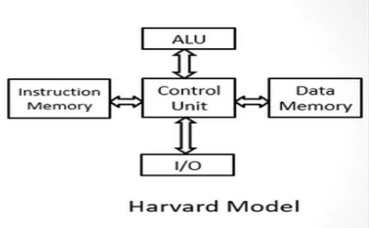

Slide 12
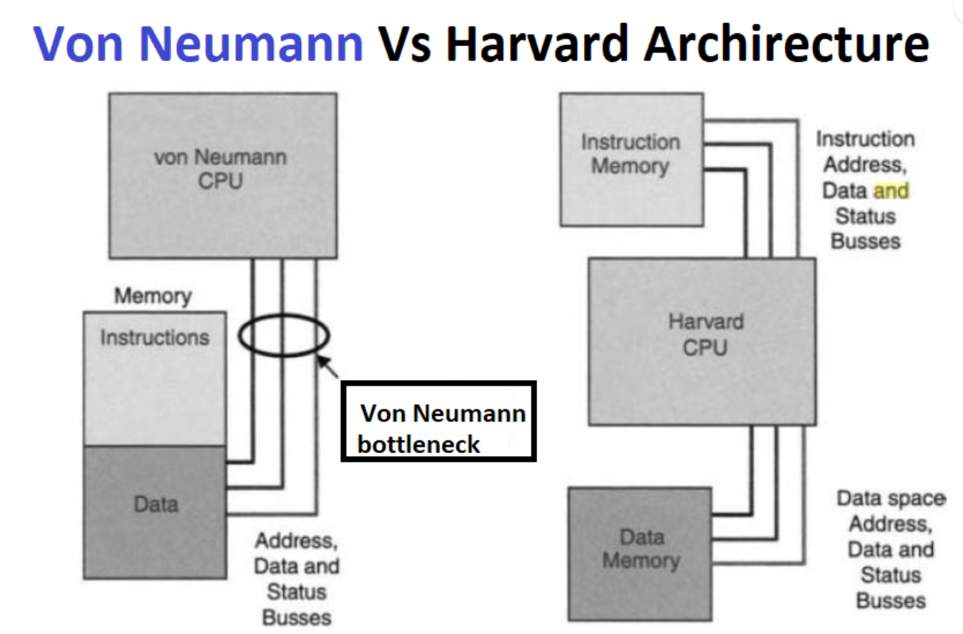
Harvard Architecture
Notes:
Discuss what you understand by von Neumann bottleneck ?

Slide 13
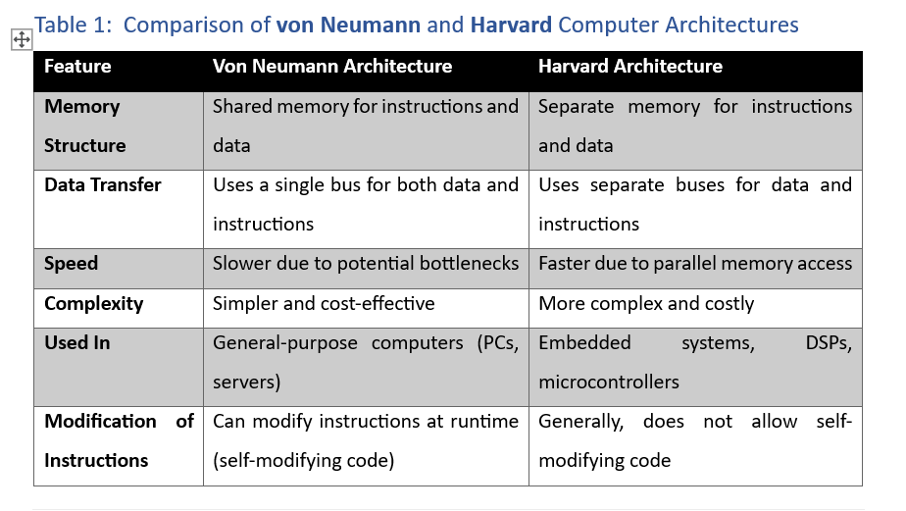
Harvard Architecture

Slide 14
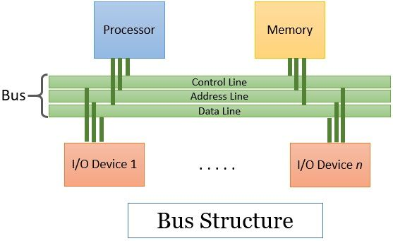
A bus is a set of electronic cables that connects key computer components

Slide 15
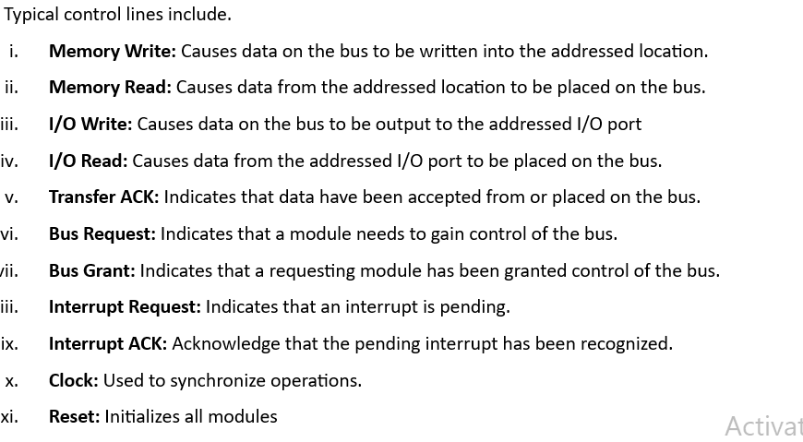

Slide 16
Bus Transmission Modes
A synchronous bus operates using a shared clock signal that synchronizes all data transfers.
Every device connected to the bus follows the same timing sequence dictated by the clock.
Therefore, all data transfers occur at fixed time intervals based on the clock signal.
A clock cycle determines when data is placed on the bus and when it is read.

Slide 17
Bus Transmission Modes
A synchronous bus operates using a handshaking signals between sender and receiver.
It uses request (REQ) and acknowledge (ACK) signals to control data flow.

Slide 18
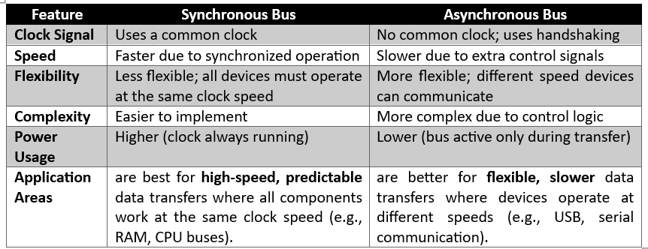
Bus Transmission Modes

Slide 19

Performance Metrics Used in Computer Architectures
Clock speed: is the number of clock cycles a processor completes per second, which influences how many instructions can be executed
Cycles Per Instruction (CPI): Defines the average number of cycles required to execute an instruction.

Slide 20


Performance Metrics Used in Computer Architectures
Million Instructions Per Second (MPIS): Measures how many millions of instructions a processor executes per second.
Floating-Point Operations Per Second (FLOPS): Measures the number of floating-point arithmetic operations a system can perform per second. .

Slide 21
Performance Metrics Used in Computer Architectures
How does lower CPI values indicate better performance ?
Does higher MIPS values indicate better performance ?

